Slide 1

PROJECT BASED LEARNING-ii
Dr. D. Y. Patil Pratishthan’s
D. Y. Patil College of Engineering, Akurdi, Pune-44
Department of Computer Engineering
Y. 2021-22
Sem - 2
Class- S.E. Computer
Division - A
Breast Cancer Detection Using Machine Learning Algorithms
Group Number: A1_1
GROUP MEMBERS :
Aditya Sadakal – SECO2122A001
Aman Shukla – SECO2122A003
Shrishti Sethi – SECO2122A013
Swapnil Bonde – SECO2122A018
GUIDED BY :
Mrs. Dhanashree Phalke

Slide 2
Contents
Problem Statement
Motivation
Introduction
Objectives
Scope of Project
Literature Review
System Architecture
Datasets
Modules
Algorithms
Results
References

Slide 3
PROBLEM STATEMENT :-
To detect if the patient has Breast Cancer or not(Malignant or Benign), by making use of the Machine Learning(ML) algorithms.

Slide 4
MOTIVATION
In order to identify the real life problem from societal need point of view and to apply knowledge in ways leading to deep, meaningful learning, Breast Cancer Detection using Machine Learning algorithms has been chosen.
The doctors do not identify each and every breast cancer patient. That’s the reason Machine Learning Engineer / Data Scientist comes into the picture because they have knowledge of math and computational power.

Slide 5
INTRODUCTION
Breast cancer is a malignant cell growth in the breast. If left untreated, the cancer spreads to other areas of the body
Breast cancer is a prevailing cause of death, and it is the only type of cancer that is widespread among women worldwide.
In 2020, there were 2.3 million women diagnosed with breast cancer and 6,85,000 deaths globally.
Breast cancer occurs in every country of the world in women at any age after puberty but with increasing rates in later life.

Slide 6

BREAST CANCER IN MEN
Men do not get Breast Cancer, it affects women only – MYTH.
It is estimated that approximately 2,190 men are diagnosed with breast cancer every year and 410 die. (Although this ratio is very less as compared to women).

Slide 7
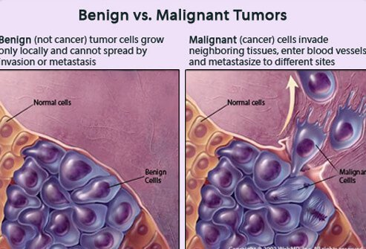
Cancerous v/s Non-Cancerous Tumours

Slide 8
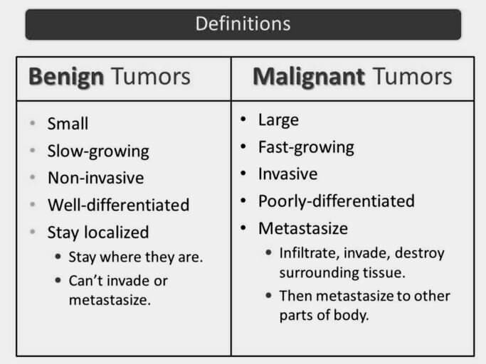

Slide 9
OBJECTIVES of the project:
To create an ML model to identify whether the breast cancer is benign or malignant.
To observe which features are most helpful in predicting malignant or benign cancer and to see general trends that may aid us in model selection and hyper parameter selection.
To predict and diagnose breast cancer, using machine-learning algorithms, and find out the most effective one with respect to confusion matrix, accuracy and precision.
To study the existing cancer detection models in depth and present the highly accurate and efficient results.
With the potential rise in the number of BC cases in India, the distress reaching is alarming. We hope our efforts will save the life of breast cancer patients.

Slide 10
Scope of project
The analysis of the results signify that the dataset when put together with different machine learning techniques provide best suited models for inference in this domain.
For Future research, we plan to evaluate different algorithms that can help us assist in accurate classification of breast cancer as either benign or malignant. In future more data could be added to the proposed dataset which would help in better training of the machine learning models and would work more accurately. Also, to improve the performance of proposed algorithm , applying other datasets for breast cancer classification can prove useful.
The findings of the present study can be a good starting point for breast cancer classification. Better results can be achieved by looking into other datasets and various machine learning algorithms. The aim is to reduce the error rates and attain maximum accuracy in future.

Slide 11
Literature Review:
In recent years, several studies have applied Machine Learning algorithms on different medical datasets to classify Breast Cancer. These algorithms show good classification results, and encourage many researchers to apply these kind of algorithms to solve challenging tasks.
Moreover, Machine Learning algorithms are used widely in medical fields to predict and classify abnormal events to create a better understanding of any incurable diseases such as cancer. The outcomes of using Machine Learning in classification are promising for breast cancer detection.
Therefore, Machine Learning approach is used in this work. A list of some literature studies related to this method is presented in the following table:

Slide 12
Paper title | Datasets | Algorithms | Results
ML classification techniques and ensemble learning for predicting the type of breast cancer recurrence, 2019 | Breast Cancer | NB, SVM, GRNN and J48 | GRNN & J48 accuracy: 91% NB & SVM: 89%
Comparative study on different classification techniques for breast cancer dataset, 2014 | Breast Cancer | J48, MLP, rough set | J48: 79.97%, MLP: 75.35%, rough set: 71.36%
Analysis of feature selection with classification: breast cancer datasets, 2011 | WBC WDBC Breast Cancer | Decision Tree with and without feature selection | Feature selection enhances the results WBC: 96.99% WDBC: 94.77% Breast Cancer: 71.32%

Slide 13
SYSTEM ARCHITECTURE
In this project the architecture is basically the dataset and the features
of the dataset . The algorithms take the features of the dataset as input and give labels as malignant or benign tumor to each of the record in the dataset.
The dataset is first split into training and testing set.
The training set is first given as input to the machine learning algorithms so that the system understands what data gives what type of outcome.
After the system is trained, the testing data is used to test whether the
system can correctly predict the class of the data. It checks the percentage
accuracy of the model.

Slide 14

SYSTEM ARCHITECTURE FLOW CHART
Data Collection
Data Preparation
Feature Scaling
&
Splitting the dataset
Studying the data features
Model Selection
Prediction
Result
Conclusion
Data Cleaning
Data Preprocessing

Slide 15
BREAST CANCER DATASET
For the models to operate efficiently we will use the Breast Cancer Wisconsin(Diagnostic) Data Set. It is a dataset of Breast Cancer patients with Malignant and Benign tumor.
Data Set information :
Features are computed from a digitized image of a fine needle aspirate (FNA) of a breast mass. They describe characteristics of the cell nuclei.
This data set has 569 rows (357 malignant cases and 212 benign cases) with 30 numeric features. The outcomes are either 1 - malignant, or 0 - benign.
The breast cancer dataset was obtained from the University of Wisconsin Hospitals, Madison from Dr. William H. Wolhberg.
It is given by Kaggle from UCI Machine Learning Repository :
https://www.kaggle.com/uciml/breast-cancer-wisconsin-data.

Slide 16
Attributes in the dataset:
Diagnosis: The diagnosis of the breast tissues(1 = Malignant, 0 = Benign)
Mean_radius: Mean of distances from center to points on the perimeter.
Mean_texture: Standard Deviation of gray-scale values
Mean_perimeter: Mean size of the core tumor
Mean_area: Area of the tumor cell
Mean_smoothness: Mean of local variation in radius lengths

Slide 17
ALGORITHMS
Supervised machine learning classifier algorithm will be used in the ML project. The different algorithms that would be used are:
1. Logistic Regression
2. Decision tree Classifier
3. Random forest Classifier
4. k-Nearest Neighbor Classifier
5. Support Vector Machine Classifier
The dataset will be used to train the ML algorithms and then test the same models and the one with the highest accuracy will be selected and thus build the best model.

Slide 18
Logistic Regression Classifier
Logistic regression is a supervised learning classification algorithm which is used to predict the probability of a target variable. It is used when the data is linearly separable and the outcome is binary or dichotomous in nature.
The dependent variable is binary in nature having data coded as either 1 (stands for success/yes) or 0 (stands for failure/no).
Logistic regression is usually used for Binary classification problems i.e predicting the output variable that is discrete in two classes. A few examples of Binary classification are Yes/No, Pass/Fail, Win/Lose, Cancerous/Non-cancerous, etc.
Logistic regression is easier to implement, interpret, and very efficient to train. And performs well when the dataset is linearly separable.

Slide 19
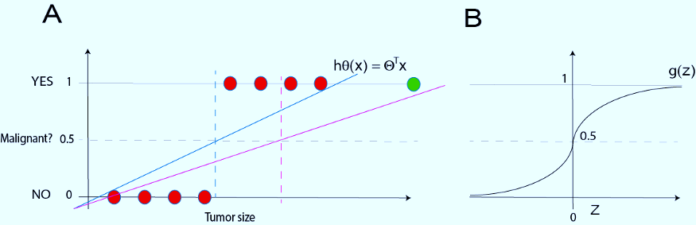
WORKING OF LOGISTIC REGRESSION CLASSIFIER
Linear Hypothesis seems not to add further information to our predictions. That happens because classification is not a linear function(refer fig A).
Logistic Hypothesis uses a function which is a sigmoid function that is non-linear. It calculates the probability that the Diagnosis output can be 0 or 1(refer fig B).

Slide 20
DECISION TREE CLASSIFIER
It is a tree structured classifier, where internal nodes represent the features of a dataset, branches represent the decision rules and each leaf node represents the outcome.
There are two nodes : Decision Node which is used to make any decision and have multiple branches and leaf nodes are the output of those decisions ,containing no further branches. The decisions or the test are performed on the basis of features of the given dataset.
It is a graphical representation for getting all the possible solutions to a problem/decision based on given conditions.
There is less requirement of data cleaning compared to other algorithms.

Slide 21

WORKING OF DECISION TREE CLASSIFIER
Step 1 : Place the best attribute of the dataset at the root of the tree.
Step 2 : Split the training set into subsets. Subsets should be made in such a way that each subset contains data with the same value for an attribute.
Step 3 : Repeat step 1 and step 2 on each subset until you find leaf nodes in all the branches of the tree.

Slide 22
Random forest classifier
Random Forest is a classifier that contains a number of decision trees on various subsets of the given dataset and takes the average to improve the predictive accuracy of that dataset.
The greater number of trees in the forest leads to higher accuracy and prevents the problem
of overfitting.
It takes less training time as compared to other algorithms.
It predicts output with high accuracy, even for the large dataset it runs efficiently.
It can also maintain accuracy when a large proportion of data is missing.

Slide 23
WORKING OF RANDOM FOREST CLASSIFIER
Step-1: Select random K data points from the training set.
Step-2: Build the decision trees associated with the selected data points (Subsets).
Step-3: Choose the number N for decision trees that you want to build.
Step-4: Repeat Step 1 & 2.
. . . .
TRAINING
DATA 1
TRAINING DATA 2
TRAINING DATA n
. . . .
DECISION TREE 1
DECISION TREE 2
DECISION TREE n
VOTING
PREDICTION

Slide 24
K-Nearest Neighbour Classifier
It is a supervised machine learning algorithm. The algorithm can be used to solve both classification
and regression problem statements.
KNN for classification: KNN can be used for classification in a supervised setting where we are
given a dataset with target labels. For classification, KNN finds the k nearest data points in the
training set and the target label is computed as the mode of the target label of these k
nearest neighbours.
KNN for Regression:KNN can be used for regression in a supervised setting where we are
given a dataset with continuous target values. For regression, KNN finds the k nearest
data points in the training set and the target value is computed as the mean of the target
value of these k nearest neighbours.

Slide 25
Working of KNN
Load the data
Initialize K to your chosen number of neighbors
3. For each example in the data
3.1 Calculate the distance between the query example and the current example from
the data.
3.2 Add the distance and the index of the example to an ordered collection
4. Sort the ordered collection of distances and indices from smallest to largest
(in ascending order) by the distances
5. Pick the first K entries from the sorted collection
6. Get the labels of the selected K entries
7. If regression, return the mean of the K labels
8. If classification, return the mode of the K labels

Slide 26
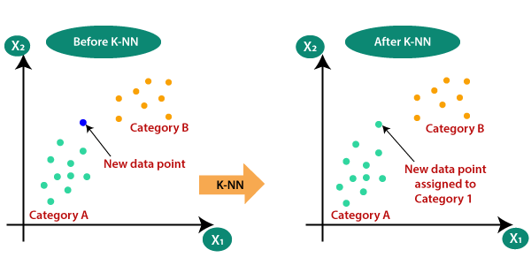

Slide 27
SUPPORT VECTOR MACHINE
What is a Support Vector Machine (SVM)?
A Support Vector Machine (SVM) is a binary linear classification whose decision boundary is explicitly constructed to minimize generalization error. It is a very powerful and versatile Machine Learning model, capable of performing linear or nonlinear classification, regression and even outlier detection.
SVM is well suited for classification of complex but small or medium sized datasets.

Slide 28

How does SVM classify?
It's important to start with the intuition for SVM with the special linearly separable classification case.
If classification of observations is "linearly separable", SVM fits the "decision boundary" that is defined by the largest margin between the closest points for each class. This is commonly called the "maximum margin hyperplane (MMH)".

Slide 29
Advantages of SVM:
Effective in high dimensional spaces.
Still effective in cases where number of dimensions is greater than the number of samples.
Uses a subset of training points in the decision function (called support vectors), so it is also memory efficient.
Versatile: different Kernel functions can be specified for the decision function. Common kernels are provided, but it is also possible to specify custom kernels.

Slide 30
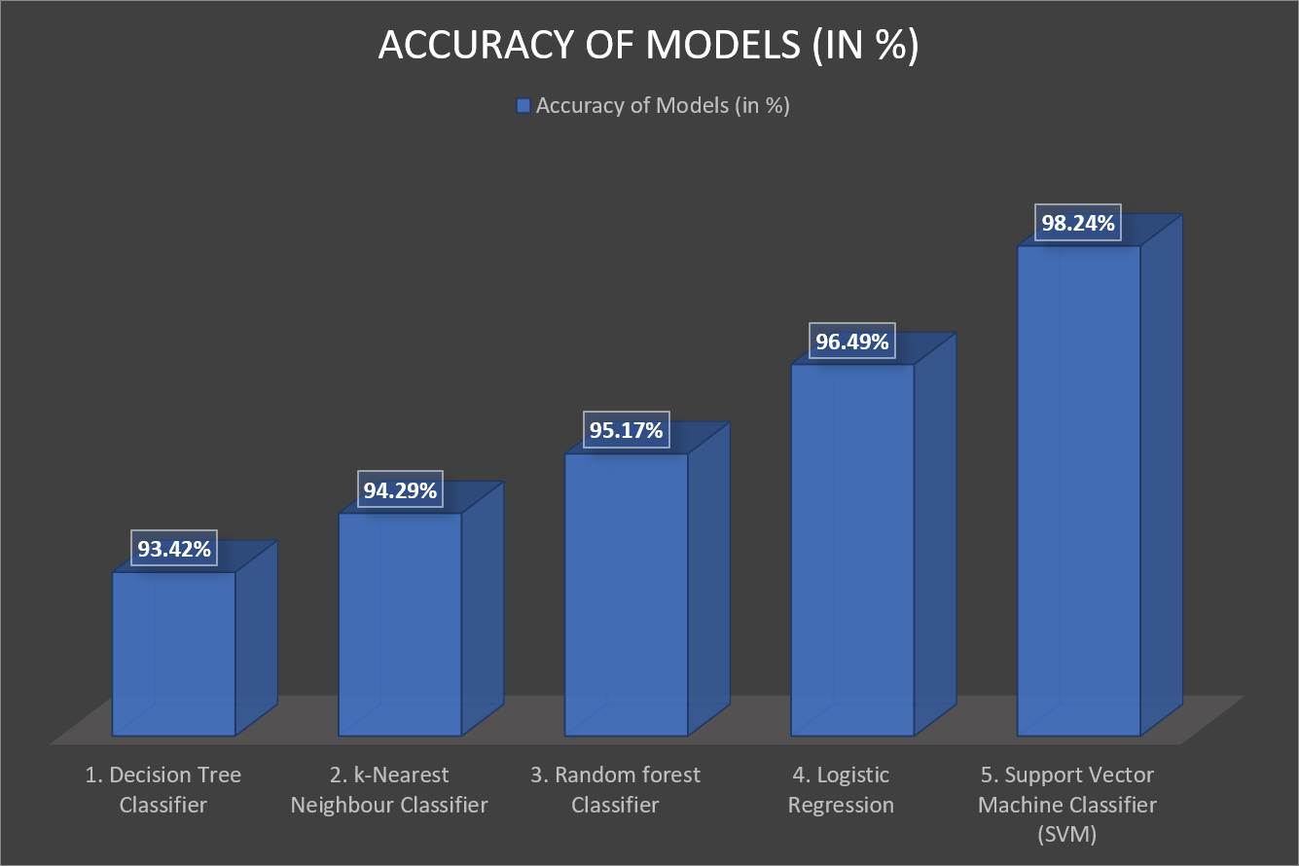
RESULTS:
After applying the different classification models, we have got below accuracies with different models:

Slide 31
RESULTS AND CONCLUSION
The aim is to classify the types of tumour and learn the various machine learning techniques such that the most suitable model capable enough not only to classify the tumour but also provide a high accuracy is found.
The different machine learning techniques like Logistic Regression, Decision Tree, Random Forest and SVM are applied to the Wisconsin Breast Cancer Diagnosis(WBCD) dataset taken from the UCI machine Learning repository. A 80%-20% training-testing split was used for evaluation and then the results were evaluated based on which the accuracy found is as following :-
Logistic Regression Classifier : 96.51%
Decision Tree Classifier : 92.39%
Random Forest Classifier : 94.73%
Support Vector Machine Classifier : 98.24%
Support Vector Classifier was the model that performed the best on the test data with an accuracy score of 98.2% and therefore was chosen to detect the cancer cells in patients.

Slide 32
References:
Dataset Reference: https://www.kaggle.com/datasets/uciml/breast-cancer-wisconsin-data
https://ieeexplore.ieee.org/abstract/document/8769187/
https://link.springer.com/chapter/10.1007/978-981-15-7205-0_10
https://www.sciencedirect.com/science/article/pii/S1877050921014629
https://ieeexplore.ieee.org/document/8741990

